Slide 1
Arduino starter pack i (a.s.p)
mcbUCHAREST@GMAIL.COM
Random guy who tells you stuff: P.P.F.

Slide 2
Short summary:
What is ARDUINO and how it works
ARDUINO IDE
Simple ARDUINO Blinking code
Simple circuit
Basic software and hardware informations

Slide 3
Arduino
Open source platform
It has a microcontroller, the IDE( Integrated Development Board ) that runs on your PC

Slide 4
What will we learn:
What is the typical ARDUINO board, what pins does it use and how it works
What is an LED, how it works and how to use it
Simple Hardware and Software capabilities

Slide 5
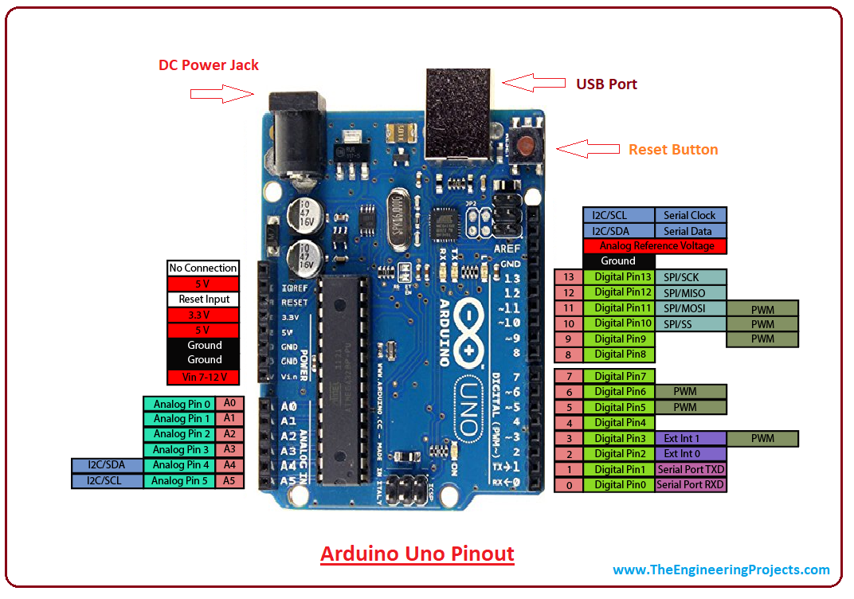
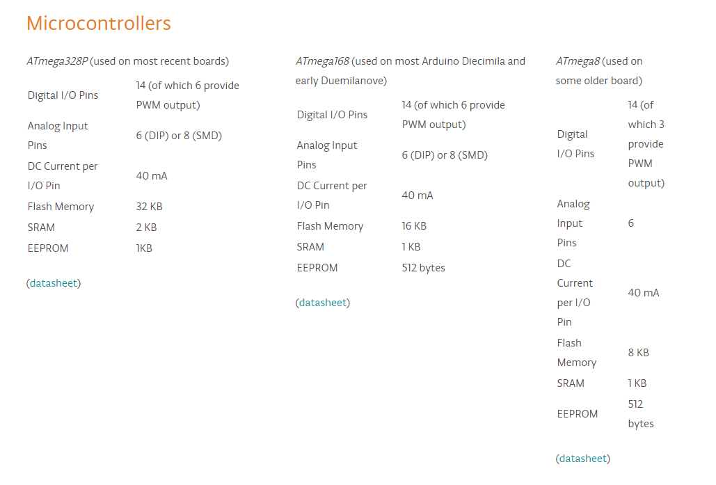
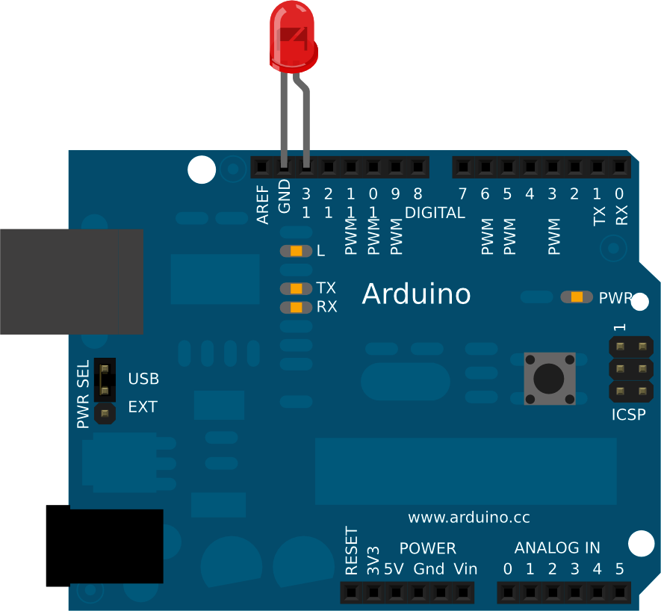
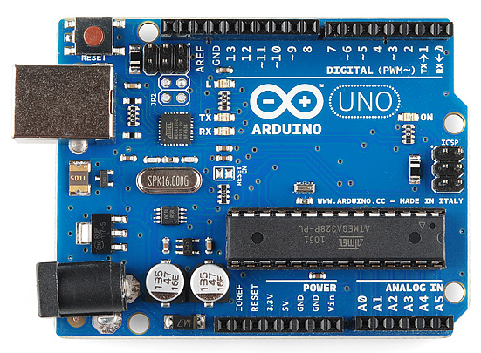
Arduino board, pins, breadboard etc

Slide 6
Arduino pins
Digital Pins
Analog Pins
Power Pins

Slide 7
Digital pins:
Can be configured as INPUT/OUTPUT via Software
Serial 0 (RX) and 1 (TX) used for communication, serial data
PWM pins: 3, 5, 6, 9, 10—they provide 8-bit PWM outputs (Pulse Width Modulation)
LED on-board pin connected to the pin number 13

Slide 8
PWM (PULSE WIDTH MODULATION) PINS-what they are and what they do:
Pulse Width Modulation, or PWM, is a technique for getting analog results with digital means. Digital control is used to create a square wave, a signal switched between on and off. This on-off pattern can simulate voltages in between full on (5 Volts) and off (0 Volts) by changing the portion of the time the signal spends on versus the time that the signal spends off. The duration of "on time" is called the pulse width. To get varying analog values, you change, or modulate, that pulse width. If you repeat this on-off pattern fast enough with an LED for example, the result is as if the signal is a steady voltage between 0 and 5v controlling the brightness of the LED.

Slide 9
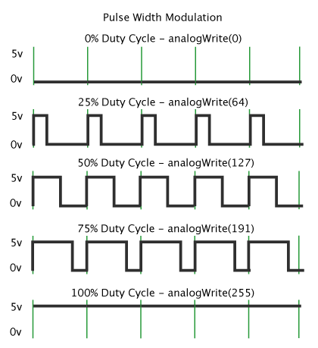

Slide 10
Analog pins:
Supports 10-bit analog-to-digital conversion (ADC) using analogRead() function.
It has two I2C ports: 4 (SDA) and 5 (SCL)

Slide 11
What is i2c and how it works:
The I2C communication bus is very popular and broadly used by many electronic devices because it can be easily implemented in many electronic designs which require communication between a master and multiple slave devices or even multiple master devices. The easy implementations comes with the fact that only two wires are required for communication between up to almost 128 (112) devices when using 7 bits addressing and up to almost 1024 (1008) devices when using 10 bits addressing.

Slide 12
How is it possible, a communication between so many devices with just to wires? Well each device has a preset ID or a unique device address so the master can choose with which devices will be communicating.
The two wires, or lines are called Serial Clock (or SCL) and Serial Data (or SDA). The SCL line is the clock signal which synchronize the data transfer between the devices on the I2C bus and it’s generated by the master device. The other line is the SDA line which carries the data.
The two lines are “open-drain” which means that pull up resistors needs to be attached to them so that the lines are high because the devices on the I2C bus are active low. Commonly used values for the resistors are from 2K for higher speeds at about 400 kbps, to 10K for lower speed at about 100 kbps.

Slide 13
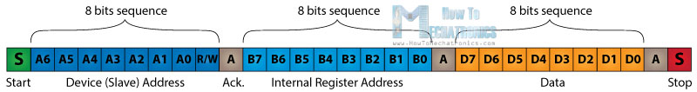
The data signal is transferred in sequences of 8 bits. So after a special start condition occurs comes the first 8 bits sequence which indicates the address of the slave to which the data is being sent. After each 8 bits sequence follows a bit called Acknowledge. After the first Acknowledge bit in most cases comes another addressing sequence but this time for the internal registers of the slave device. After the addressing sequences follows the data sequences as many until the data is completely sent and it ends with a special stop condition.

Slide 14
Power pins:
VIN—external power source pin, you can supply voltage trough this pin
5V
3V3
GND

Slide 15
What is a led and how to use it with Arduino:
LED- Light Emitting Diode – A semiconductor light source that emits light when current flows trough it. Electrons in the semiconductor recombine with electron holes, releasing energy in the form of photons. The color of the light (corresponding to the energy of the photons) is determined by the energy required for electrons to cross the band gap of the semiconductor.

Slide 16
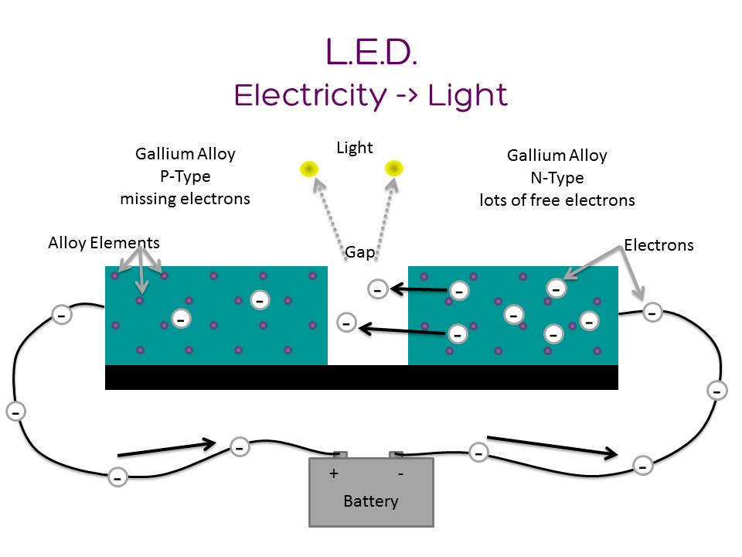
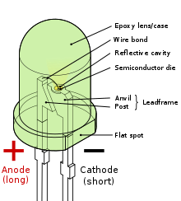
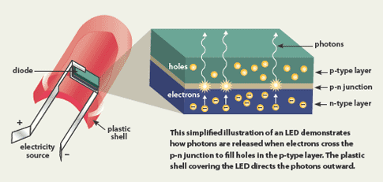

Slide 17
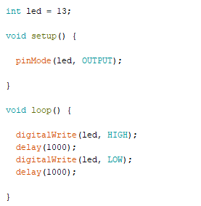
Sample Arduino led program:

Slide 18


What you need to remember:

Slide 19
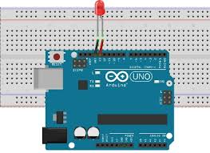
Simple circuit:

Slide 20
webography
https://en.wikipedia.org/wiki/Webography
https://en.wikipedia.org/wiki/Light-emitting_diode
https://learn.sparkfun.com/tutorials/what-is-an-arduino/all
https://www.arduino.cc/en/guide/introduction
https://www.arduino.cc/en/reference/board
https://thatsthefinger.com/
http://nooooooooooooooo.com/

